Slide 1
Unit6: Trees
Prepared by
Gobinda Subedi
BIT, KIST

Slide 2
Introduction
Non-Recursive Definition of a Tree:
A tree is an abstract model of a hierarchical structure that consists of finite set of nodes and these nodes have a parent-child relationship.
Here, A has four children: B, C, D and E
A
B
C
D
E
F
G
H
I
J
K
L
M
N

Slide 3
Introduction Contd..
Tree is a sequence of nodes.
For Every tree there is always a starting node known as root node.
Every node other than the root has a parent node.
Nodes may have any number of children.
Every node c, except the root, is connected by an edge from exactly one other node p. Node p is c’s parent, and c is one of p’s children.
A leaf is a node that has no children.

Slide 4
Tree Introduction contd..
Recursive Definition of a Tree:
A tree of order n is a set of nodes that is
an empty set of nodes, or
has one node called the root from which zero or more trees (subtrees) descend.
A
B
C
D
E
F
G
H
I
J
K
Subtree

Slide 5
More terminologies of Tree
A tree with N nodes must have N-1 edges, every node except the root has an incoming edge.
Nodes with the same parents are called siblings.
If there is a path from node u to node v, then u is an ancestor of v and v is a descendant of u.
Depth of a node is the path length from the root to that node. The root node has a depth of 0.
Depth of a tree is the maximum level of any leaf in the tree. This is equal to the longest path from the root to any leaf.
Level of a particular node refers to how many generations the node is from the root. It is the same thing as the depth

Slide 6
More terminologies of Tree
Degree of a node:
The degree of a node is the number of children of that node.
Degree of a Tree:
The degree of a tree is the maximum degree of a node in a given tree.
Path:
It is the sequence of consecutive edges from source node to destination node. There is a single unique path from the root to any node.
Height of a node:
The height of a node is the maximum path length from that node to a leaf node. A leaf node has a height of 0.
Height of a tree:
The height of a tree is the height of the root.

Slide 7
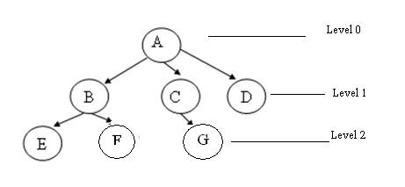
Tree Illustration
A is the root node
B is the parent of E and F
D is the sibling of B and C
E and F are children of B
E, F, G, D are external nodes or leaves
A, B, C are internal nodes
Depth of F is 2
the height of tree is 2
the degree of node A is 3
The degree of tree is 3

Slide 8
Application of Tree
Directory structure of a file store
Structure of arithmetic expressions
Implement a data compression algorithm. (Hoffman algorithm).
It is also used in compiler design.
Decision processing
Searching.

Slide 9
Binary Tree
A binary tree is a finite set of elements that are either empty or is partitioned into three disjoint subsets. The first subset contains a single element called the root of the tree. The other two subsets are themselves binary trees called the left and right sub-trees of the original tree.
A left or right sub tree can be empty.
Each element of a binary tree is called a node of the tree.

Slide 10
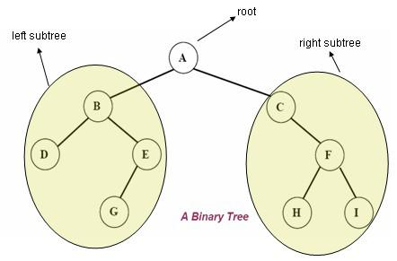
Binary tree Illustration
If a binary tree contains m nodes at level l, it contains at most 2m nodes at level l+1.
Since a binary tree can contain at most 1 node at level 0 (the root), it contains at most 2^{l} nodes at level l.
The maximum number of nodes in a binary tree of height k is 2^{k+1}-1, k>=0.

Slide 11
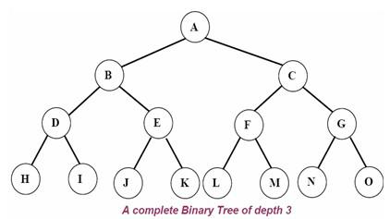
Type of Binary Tree
Complete binary tree
Strictly binary tree
Almost complete binary tree
Complete binary tree: A complete binary tree of depth d is called strictly binary tree if all of whose leaves are at level d. A complete binary tree with depth d has 2^{d} leaves and 2^{d} -1 non-leaf nodes(internal).

Slide 12
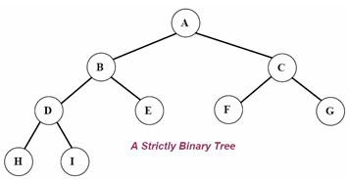
Type of Binary Tree condt..
Strictly binary tree: If every non-leaf node in a binary tree has nonempty left and right sub-trees, then such a tree is called a strictly binary tree.

Slide 13
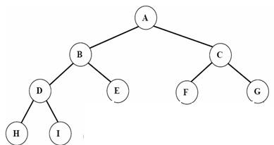
Almost complete binary tree: A binary tree of depth d is an almost complete binary tree if:
Any node n_{d} at level less than d-1 has two sons.
For any node n_{d} in the tree with a right descendant at level d, n_{d} must have a left son and every left descendant of n_{d} is either a leaf at level d or has two sons.

Slide 14
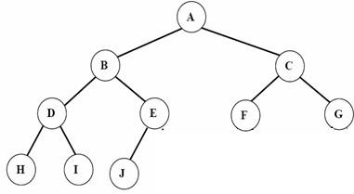
Fig: Almost complete binary tree but not strictly binary tree.
Since node E has a left son but not a right son.

Slide 15
C representation for Binary tree:
struct bnode
{
int info;
struct bnode *left;
struct bnode *right;
};
struct bnode *root=NULL;

Slide 16
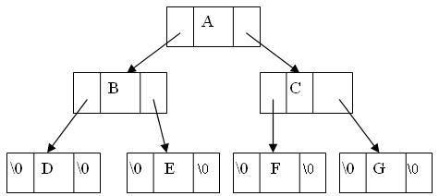
Structure of Binary tree

Slide 17
Tree Traversal
The tree traversal is a way in which each node in the tree is visited exactly once in a symmetric manner.
There are three popular methods of traversal
Pre-order traversal
In-order traversal
Post-order traversal

Slide 18
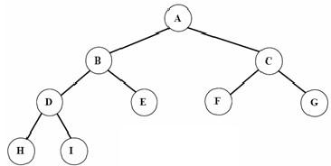
Tree Traversal condt..
Pre-order traversal:
The preorder traversal of a nonempty binary tree is defined as follows:
Visit the root node
Traverse the left sub-tree in preorder
Traverse the right sub-tree in preorder
The preorder traversal output of the
given tree is: A B D H I E C F

Slide 19
C function for preorder traversing:
void preorder(struct bnode *root)
{
if(root!=NULL)
{
printf(“%c”, root->info);
preorder(root->left);
preorder(root->right);
}
}

Slide 20
Tree Traversal condt..
In-order traversal:
The inorder traversal of a nonempty binary tree is defined as follows:
Traverse the left sub-tree in inorder
Visit the root node
Traverse the right sub-tree in inorder
The inorder traversal output of the given tree is: H D I B E A F C G
C function for inorder traversing:
void inorder(struct bnode *root)
{
if(root!=NULL)
{
inorder(root- >left);
printf(“%c”, root->info);
inorder(root->right);
}
}

Slide 21
Tree Traversal condt..
Post-order traversal:
The post-order traversal of a nonempty binary tree is defined as follows:
Traverse the left sub-tree in post-order
Traverse the right sub-tree in post-order
Visit the root node
The post-order traversal output of the given tree is: H I D E B F G C A
function for post-order traversing: void post-order(struct bnode *root)
{
if(root!=NULL)
{
post-order(root->left);
post-order(root->right);
printf(“%c”, root->info);
}
}

Slide 22
Binary Search Tree
A binary search tree (BST) is a binary tree that is either empty or in which every node contains a key (value) and satisfies the following conditions:
All keys in the left sub-tree of the root are smaller than the key in the root node
All keys in the right sub-tree of the root are greater than the key in the root node
The left and right sub-trees of the root are again binary search trees

Slide 23
BST contd..
A binary search tree is a binary
tree in which all nodes in the
left subtree of a node have
lower values than the
node. All nodes in the
right subtree of a node
have higher value than the node.
8
5
11
2
6
10
12
4
7
9
14
13

Slide 24
Comparision
8
5
5
11
4
8
2
7
6
10
18
1
7
11
4
15
20
3
NOT A
BINARY SEARCH TREE
BINARY SEARCH TREE
21
Notes:
Why isn’t the one on the right a BST?
Three children of 5
20 has a left child larger than it.
What’s wrong with 11?
Even though 15 isn’t a direct child, it _still_ needs to be less than 11!

Slide 25
Operations on BST
Following operations can be done in BST:
Search(k, T): Search for key k in the tree T. If k is found in some node of tree then return true otherwise return false.
Insert(k, T): Insert a new node with value k in the info field in the tree T such that the property of BST is maintained.
Delete(k, T):Delete a node with value k in the info field from the tree T such that the property of BST is maintained.
FindMin(T), FindMax(T): Find minimum and maximum element from the given nonempty BST.

Slide 26
Searching through the BST
Problem: Search for a given target value in a BST.
Idea: Compare the target value with the element in the root node.
If the target value is equal, the search is successful.
If target value is less, search the left subtree.
If target value is greater, search the right subtree.
If the subtree is empty, the search is unsuccessful.

Slide 27
BST search algorithm:
To find which if any node of a BST contains an element equal to target:
Set curr to the BST’s root.
Repeat:
If curr is null:
Terminate with answer none.
Otherwise, if target is equal to curr’s element:
Terminate with answer curr.
Otherwise, if target is less than curr’s element:
Set curr to curr’s left child.
Otherwise, if target is greater than curr’s element:
Set curr to curr’s right child.
end

Slide 28
Struct bnode * BinSearch(struct bnode *root , int key)
{
if(root == NULL)
{
printf(“The number does not exist”);
exit(1);
}
else if (key == root->info)
{
printf(“The searched item is found”);
return root;
}
else if(key < root->info)
BinSearch(root->left, key);
else
BinSearch(root->right, key);
}

Slide 29
Insertion of a node in BST:
To insert a new item in a tree, we must first verify that its key is different from those of existing elements. To do this a search is carried out. If the search is unsuccessful, then item is inserted.
Idea: To insert a new element into a BST, proceed as if searching for that element. If the element is not already present, the search will lead to a null link. Replace that null link by a link to a leaf node containing the new element.

Slide 30
BST insertion algorithm:
To insert the element elem into a BST:
Set parent to null, and Set curr to the BST’s root.
Repeat:
If curr is null:
Replace the null link from which curr was taken
(either the BST’s root or parent’s left child or parent’s right child) by a link to a newly-created leaf node with element elem.
Terminate.
Otherwise, if elem is equal to curr’s element:
Terminate.
Otherwise, if elem is less than curr’s element:
Set parent to curr, and set curr to curr’s left child.
Otherwise, if elem is greater than curr’s element:
Set parent to curr, and set curr to curr’s right child.
3.End

Slide 31
BST insertion algorithm contd..
Struct bnode * insert(struct bnode *root, int item)
{
if(root=NULL)
{
root=(struct bnode*)malloc (sizeof(struct bnode));
root->left=root->right=NULL;
root->info=item;
}
Else
{
If (item<root->info)
root->left=insert(root->left, item);
else
root->right=insert(root->right, item);
}
}

Slide 32
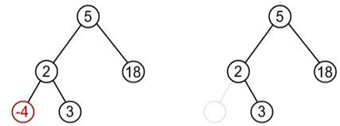
BST Deletion algorithm
1. The node to be deleted may be a leaf node:
In this case simply delete a node and set null pointer to its parents those side at which this deleted node exist.

Slide 33
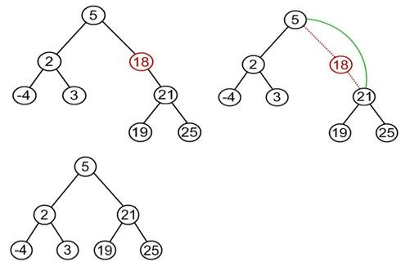
BST Deletion algorithm
2. The node to be deleted has one child:
In this case the child of the node to be deleted is appended to its parent node.
Suppose node to be deleted is 18

Slide 34
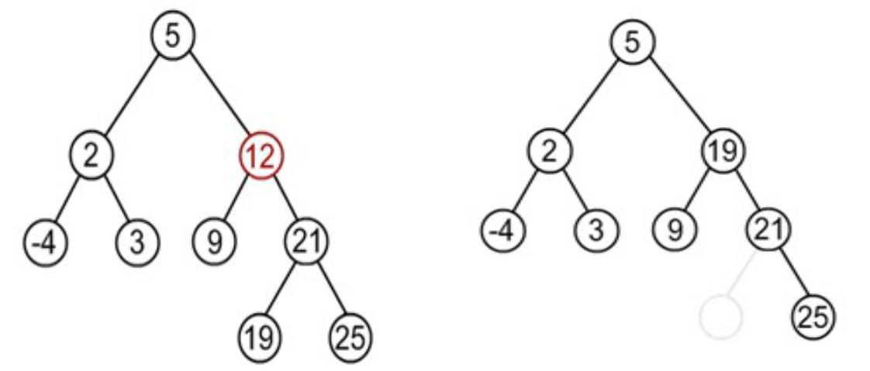
BST Deletion algorithm
3. The node to be deleted has two children:
In this case node to be deleted is replaced by its in-order successor node.
OR
If the node to be deleted is either replaced by its right sub-trees leftmost node or its left sub-trees rightmost node.
Notes:
Suppose node to deleted is 12
Find minimum element in the right sub-tree of the node to be removed. In current example it is 19.

Slide 35
General algorithm to delete a node from a BST:
start
if a node to be deleted is a leaf node at left side then simply delete and set null pointer to it's parent's left pointer.
If a node to be deleted is a leaf node at right side then simply delete and set null pointer to it's parent's right pointer
if a node to be deleted has on child then connect it's child pointer with it's parent pointer and delete it from the tree
if a node to be deleted has two children then replace the node being deleted either by
right most node of it's left sub-tree or
left most node of it's right sub-tree.
End

Slide 36
Find Min Function
struct bnode *find_min(struct bnode *root)
{
if(root==NULL)
Return 0;
else if(root- >left==NULL)
{
printf(“The min value in the tree is %d ”, root->info);
return root;
}
else
return(find_min(root->left));
}

Slide 37
Huffman Algorithm
Huffman coding is based on the frequency of occurrence of a data item. The principle is to use a lower number of bits to encode the data that occurs more frequently. Codes are stored in a Code Book which may be constructed for each image or a set of images. In all cases the code book plus encoded data must be transmitted to enable decoding.
Now, this algorithm is standard method used for data compression.

Slide 38
Hoffman Algorithm
Algorithm
1. Initialization: Put all nodes in an OPEN list, keep it sorted at all times (e.g., ABCDE).
2. Repeat until the OPEN list has only one node left:
(a) From OPEN pick two nodes having the lowest frequencies/probabilities, create a parent node of them.
(b) Assign the sum of the children's frequencies/probabilities to the parent node and insert it into OPEN.
(c) Assign code 0, 1 to the two branches of the tree, and delete the children from OPEN.

Slide 39
Time Complexity
Searching, insertion, and removal in a binary search tree is O(h), where h is the height of the tree.
However, in the worst-case search, insertion, and removal time is O(n), if the height of the tree is equal to n. Thus in some cases searching, insertion, and removal is no better than in a sequence.
Thus, to prevent the worst case, we need to develop a rebalancing scheme for the BST.

Slide 40
AVL Tree
A binary tree is said to be balanced, if the difference between the heights of left and right subtrees of every node in the tree is 1.
Named after their inventor Adelson, Velski & Landis, AVL trees are height balancing binary search tree.AVL tree checks the height of the left and the right sub-trees and assures that the difference is not more than 1. This difference is called the Balance Factor.

Slide 41
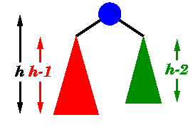
AVL Tree

Slide 42
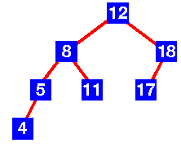
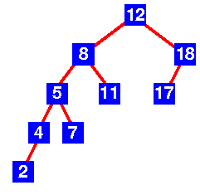
AVL Tree contd..
AVL Tree
Not a AVL Tree

